Slide 1
Discrete Mathematics
Chapter 01
The Foundations: Logic and Proofs

Slide 2
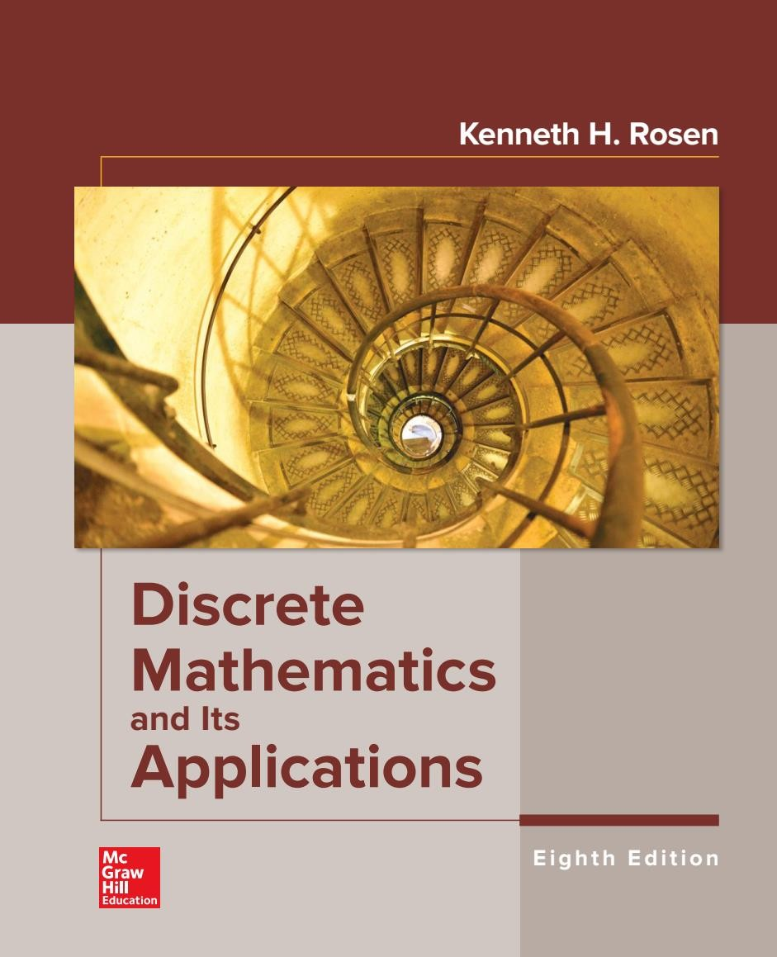
Lectures Reference
Text book
2019

Slide 3
Course Objectives
Learn how to think mathematically.
Grasp the basic logical and reasoning mechanisms of mathematical thought.
Acquire logic and proof as the basics for abstract thinking.
Improve problem-solving skills.
Grasp the basic elements of induction, recursion, combination and discrete structures.

Slide 4
DM is a Gateway Course
Topics in discrete mathematics will be important in many
courses that you will take in the future:
Computer Science: Computer Architecture, Data Structures, Algorithms, Programming Languages, Compilers, Computer Security, Databases, Artificial Intelligence, Networking, Graphics, Game Design, Theory of Computation, ……
Mathematics: Logic, Set Theory, Probability, Number Theory, Abstract Algebra, Combinatorics, Graph Theory, Game Theory, Network Optimization, …
Other Disciplines: You may find concepts learned here useful in courses in philosophy, economics, linguistics, and other departments.

Slide 5
Course Syllabus
The Foundations: Logic and Proofs.
Basic Structures: Sets, Functions, Sequences, and Sums.
Algorithms.
Induction and Recursion.
Graphs.
Trees.

Slide 6
Chapter 1: Logic and Proofs
Introduction to Propositional Logic.
Compound Propositions.
Applications of Propositional Logic.
Propositional Equivalences.
Predicates and Quantifiers.
Arguments.
Proofs Techniques.

Slide 7
Introduction to Propositional Logic (1/4)
What is Logic?
Logic is the discipline that deals with the methods of reasoning.
On an elementary level, logic provides rules and techniques for determining whether a given argument is valid.
Logical reasoning is used in mathematics to prove theorems.

Slide 8
Introduction to Propositional Logic (2/4)
The basic building blocks of logic is Proposition
A proposition (or statement) is a declarative sentence
that is either true or false, but not both.
The area of logic that deals with propositions is called
propositional logics.

Slide 9
Introduction to Propositional Logic (3/4)
Examples:
Propositions | Truth value
2 + 3 = 5 | True
5 − 2 = 1 | False
Today is Friday | False
𝑥 + 3 = 7 , for 𝑥 = 4 | True
Cairo is the capital of Egypt | True
Sentences | Is a Proposition
What time is it? | Not propositions
Read this carefully. | Not propositions
𝑥 + 3 = 7 | Not propositions

Slide 10
Introduction to Propositional Logic (4/4)
We use letters to denote propositional variables
𝒑, 𝒒, 𝒓, 𝒔, …
The truth value of a proposition is true, denoted by T, if it is a true proposition and false, denoted by F, if it is a false proposition.

Slide 11
Compound Propositions (1/23)
Compound Proposition
Compound Propositions are formed propositions using logical operators.
from
existing

Slide 12
Compound Propositions (2/23)
Negation
Other notations you might see are

Slide 13
Compound Propositions (3/23)
Example
Find the negation of the proposition
𝑝: “Cairo is the capital of Egypt”

Slide 14
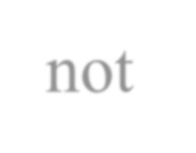
Compound Propositions (4/23)
Example: Solution
Find the negation of the proposition
𝑝: “Cairo is the capital of Egypt” The negation is
¬𝑝: “It is not the case that Cairo is the capital of Egypt”
This negation can be more simply expressed as
¬𝑝: “Cairo is not the capital of Egypt”

Slide 15
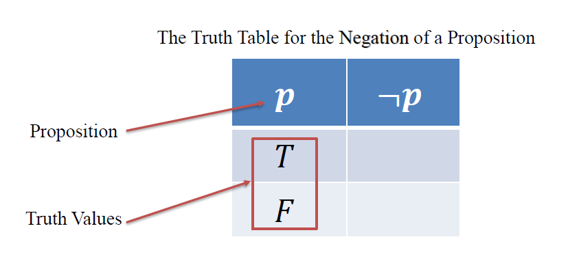
Compound Propositions (5/23)
Truth Table
Truth Table: is a table that gives the truth values of a compound statement.

Slide 16
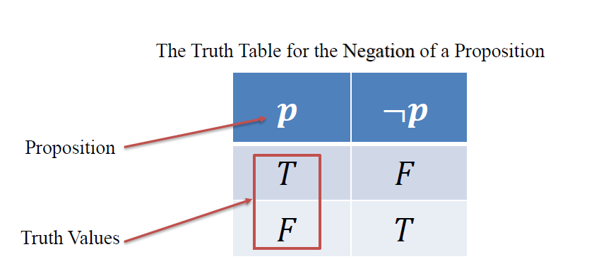
Compound Propositions (5/23)
Truth Table
Truth Table: is a table that gives the truth values of a compound statement.

Slide 17
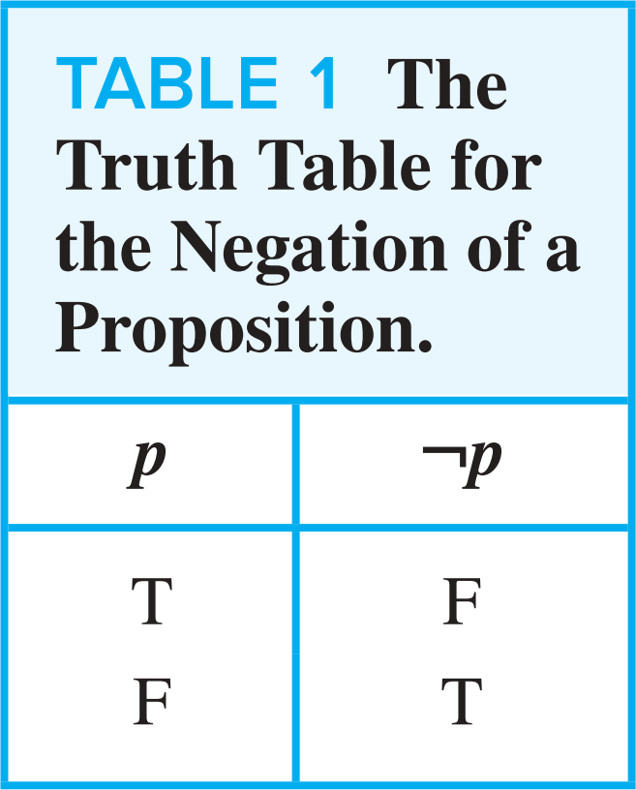
Compound Propositions (6/23)
Negation

Slide 18
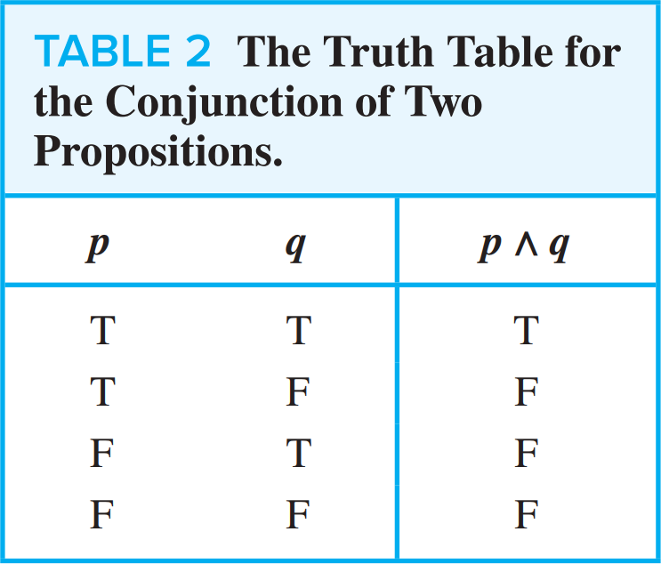
Compound Propositions (7/23)
Logical Connectives
Example
𝑝:
𝑞:
Today is Friday.
It is raining today.
𝑝 𝖠 𝑞: Today is Friday and it is raining today.

Slide 19
Compound Propositions (8/23)
Logical Connectives
Example
𝑝:
𝑞:
Today is Friday.
It is raining today.
𝑝 ∨ 𝑞: Today is Friday or it is raining today.

Slide 20
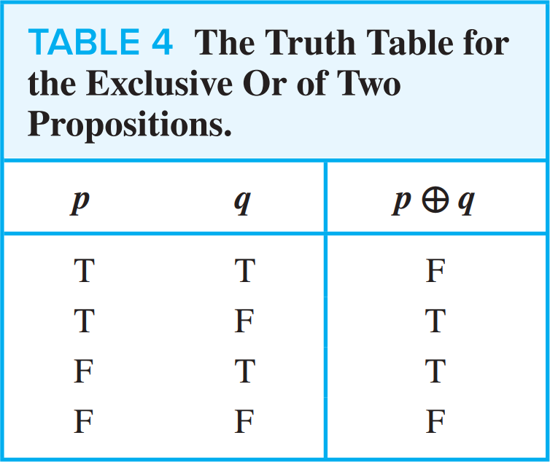
Compound Propositions (9/23)
Logical Connectives
Example
p : They are parents.
q : They are children.
p ⊕ q : They are parents or children but not both.

Slide 21
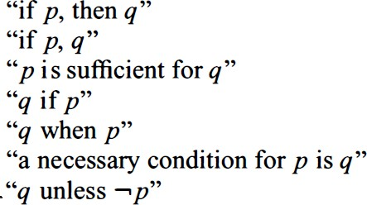
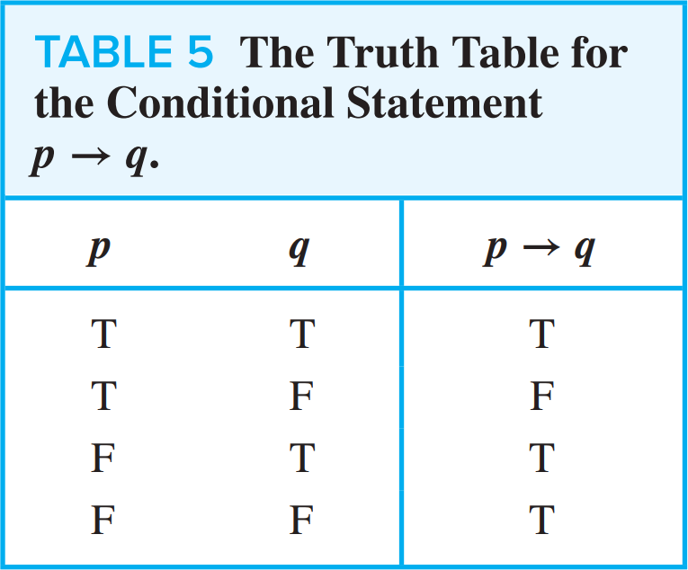
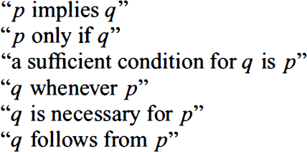
Compound Propositions (10/23)
Logical Connectives

Slide 22
Compound Propositions (10/23)
Logical Connectives

Slide 23
Compound Propositions (11/23)
Logical Connectives
1

Slide 24
Compound Propositions (12/23)
Logical Connectives
2

Slide 25
Compound Propositions (12/23)
Logical Connectives
2

Slide 26
Compound Propositions (13/23)
Logical Connectives
3

Slide 27
Compound Propositions (13/23)
Logical Connectives
3

Slide 28
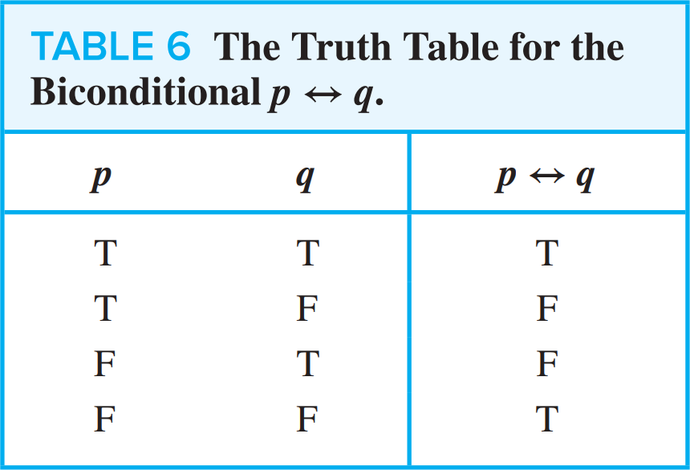
Compound Propositions (14/23)
Logical Connectives

Slide 29
Compound Propositions (15/23)
Truth Tables of Compound Propositions
1

Slide 30
Compound Propositions (16/23)
Truth Tables of Compound Propositions
1

Slide 31
Compound Propositions (16/23)
Truth Tables of Compound Propositions
1

Slide 32
Compound Propositions (16/23)
Truth Tables of Compound Propositions
1

Slide 33
Compound Propositions (16/23)
Truth Tables of Compound Propositions
1

Slide 34
Compound Propositions (16/23)
Truth Tables of Compound Propositions
1

Slide 35
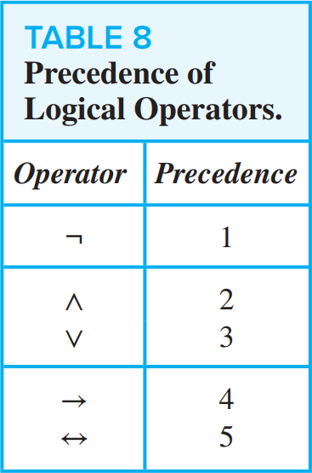
Compound Propositions (17/23)
Precedence of Logical Operators

Slide 36
Compound Propositions (18/23)
Truth Tables of Compound Propositions
2

Slide 37
Compound Propositions (19/23)
Truth Tables of Compound Propositions
2
𝒑 | 𝒒 | 𝒓 | ¬𝒒 | 𝒑 𝖠 ¬𝒒 | 𝒑 𝖠 ¬𝒒 → 𝒓

Slide 38
Compound Propositions (19/23)
Truth Tables of Compound Propositions
2
𝒑 | 𝒒 | 𝒓 | ¬𝒒 | 𝒑 𝖠 ¬𝒒 | 𝒑 𝖠 ¬𝒒 → 𝒓
𝐓 | 𝐓 | 𝐓
𝐓 | 𝐓 | 𝐅
𝐓 | 𝐅 | 𝐓
𝐓 | 𝐅 | 𝐅
𝐅 | 𝐓 | 𝐓
𝐅 | 𝐓 | 𝐅
𝐅 | 𝐅 | 𝐓
𝐅 | 𝐅 | 𝐅

Slide 39
Compound Propositions (19/23)
Truth Tables of Compound Propositions
2
𝒑 | 𝒒 | 𝒓 | ¬𝒒 | 𝒑 𝖠 ¬𝒒 | 𝒑 𝖠 ¬𝒒 → 𝒓
𝐓 | 𝐓 | 𝐓 | 𝐅
𝐓 | 𝐓 | 𝐅 | 𝐅
𝐓 | 𝐅 | 𝐓 | 𝐓
𝐓 | 𝐅 | 𝐅 | 𝐓
𝐅 | 𝐓 | 𝐓 | 𝐅
𝐅 | 𝐓 | 𝐅 | 𝐅
𝐅 | 𝐅 | 𝐓 | 𝐓
𝐅 | 𝐅 | 𝐅 | 𝐓

Slide 40
Compound Propositions (19/23)
Truth Tables of Compound Propositions
2
𝒑 | 𝒒 | 𝒓 | ¬𝒒 | 𝒑 𝖠 ¬𝒒 | 𝒑 𝖠 ¬𝒒 → 𝒓
𝐓 | 𝐓 | 𝐓 | 𝐅 | 𝐅
𝐓 | 𝐓 | 𝐅 | 𝐅 | 𝐅
𝐓 | 𝐅 | 𝐓 | 𝐓 | 𝐓
𝐓 | 𝐅 | 𝐅 | 𝐓 | 𝐓
𝐅 | 𝐓 | 𝐓 | 𝐅 | 𝐅
𝐅 | 𝐓 | 𝐅 | 𝐅 | 𝐅
𝐅 | 𝐅 | 𝐓 | 𝐓 | 𝐅
𝐅 | 𝐅 | 𝐅 | 𝐓 | 𝐅

Slide 41
Compound Propositions (19/23)
Truth Tables of Compound Propositions
2
𝒑 | 𝒒 | 𝒓 | ¬𝒒 | 𝒑 𝖠 ¬𝒒 | 𝒑 𝖠 ¬𝒒 → 𝒓
𝐓 | 𝐓 | 𝐓 | 𝐅 | 𝐅 | 𝐓
𝐓 | 𝐓 | 𝐅 | 𝐅 | 𝐅 | 𝐓
𝐓 | 𝐅 | 𝐓 | 𝐓 | 𝐓 | 𝐓
𝐓 | 𝐅 | 𝐅 | 𝐓 | 𝐓 | 𝐅
𝐅 | 𝐓 | 𝐓 | 𝐅 | 𝐅 | 𝐓
𝐅 | 𝐓 | 𝐅 | 𝐅 | 𝐅 | 𝐓
𝐅 | 𝐅 | 𝐓 | 𝐓 | 𝐅 | 𝐓
𝐅 | 𝐅 | 𝐅 | 𝐓 | 𝐅 | 𝐓

Slide 42
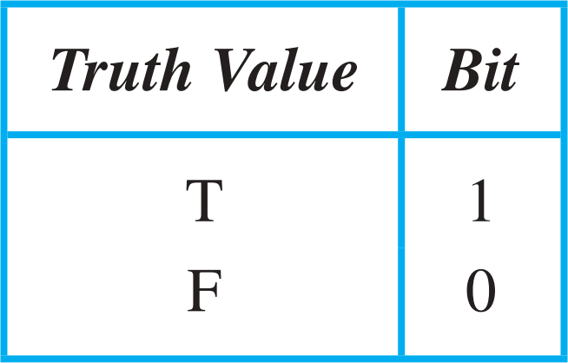
Compound Propositions (20/23)
Logic and Bit Operations
Computers represent information using bits. A bit is a symbol with two possible values, namely, 0 (zero) and 1 (one).

Slide 43
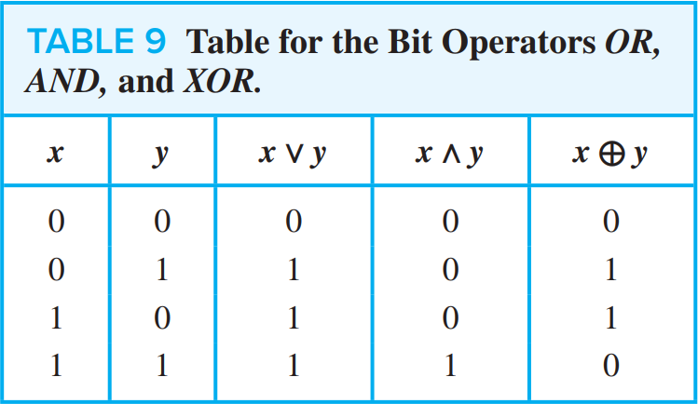
Compound Propositions (21/23)
Computer Bit Operations
We will also use the notation OR, AND, and XOR for the operators ∨, 𝖠, and ⊕, as is done in various programming languages.

Slide 44
Compound Propositions (22/23)
Bit Strings
Information is often represented using bit strings, which are lists of zeros and ones. When this is done, operations on the bit strings can be used to manipulate this information.

Slide 45
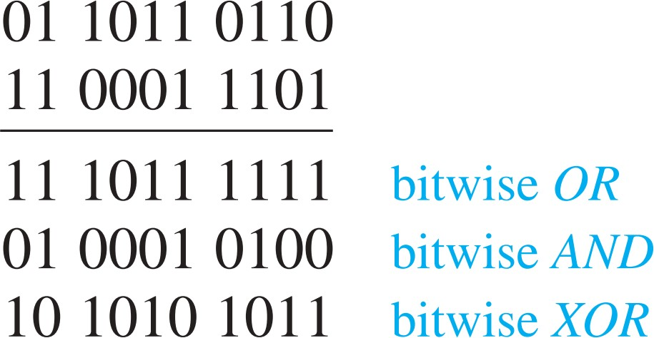
Compound Propositions (23/23)
Example
Find the bitwise OR, bitwise AND, and bitwise XOR of the bit strings 01 1011 0110 and 11 0001 1101

